Slide 1
4.ELECTRIC TRACTION

Slide 2
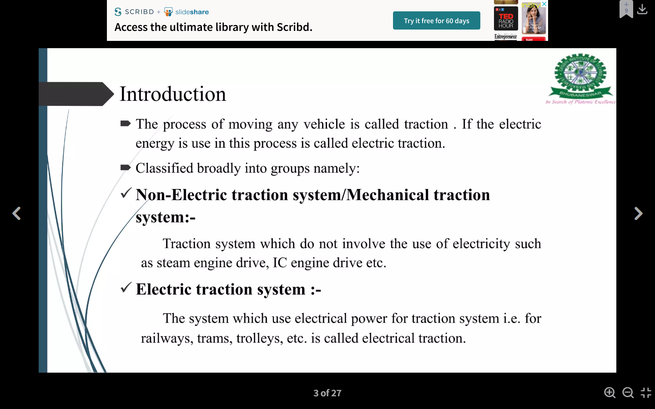

Slide 3
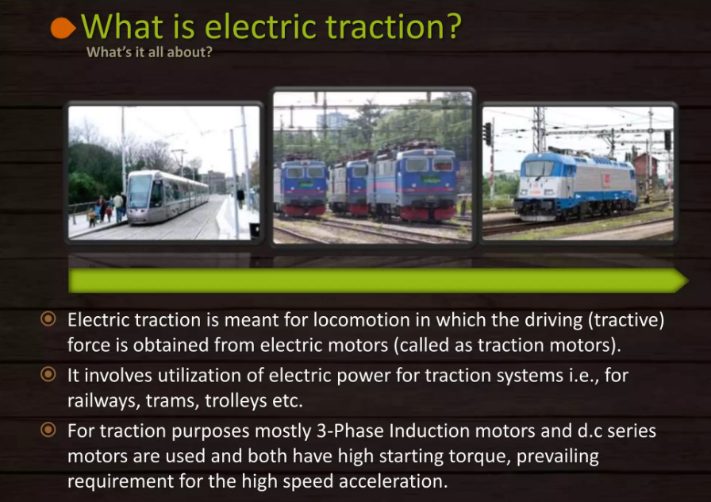

Slide 4
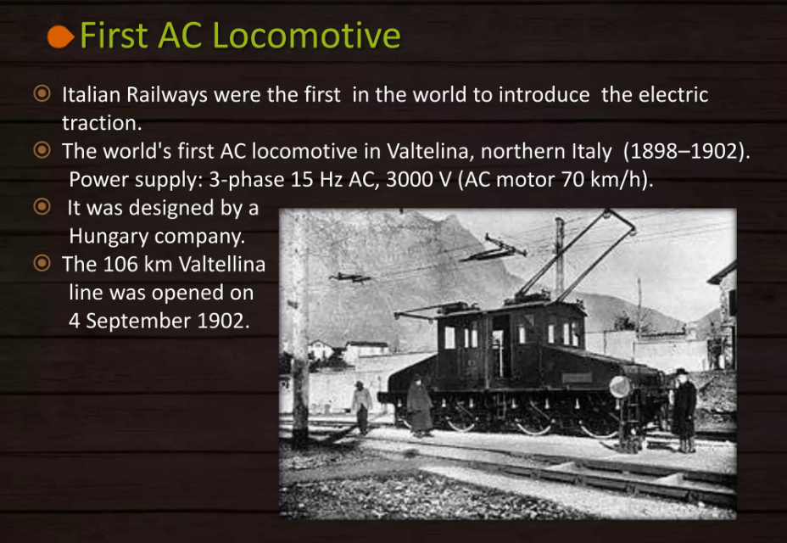

Slide 5
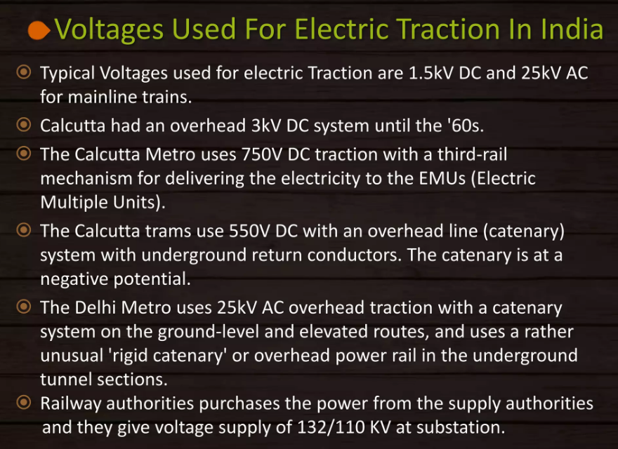

Slide 6
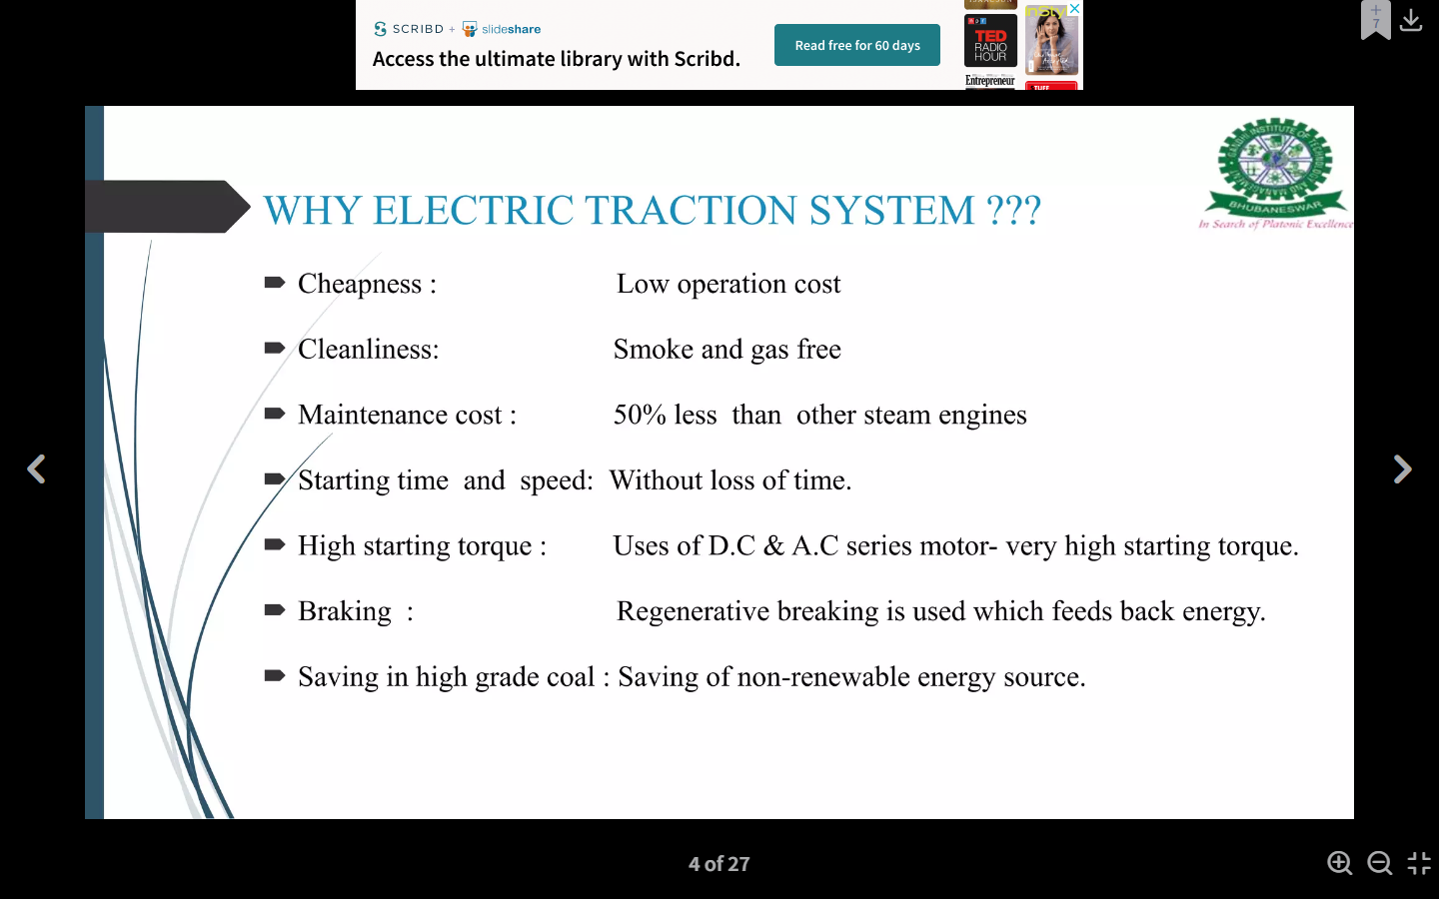
WHY ELECTRIC TRACTION SYSTEM?

Slide 7
Requirements of ideal traction system
Normally, no single traction system fulfills the requirements of ideal traction system, why because each traction system has its merits and suffers from its own demerits, in the fields of applications.
The requirements of ideal traction systems are:
Ideal traction system should have the capability of developing high tractive effort in order to have rapid acceleration.
The speed control of the traction motors should be easy.
Vehicles should be able to run on any route, without interruption.
Equipment required for traction system should be minimum with high efficiency.

Slide 8
It must be free from smoke, ash, durt, etc.
Regenerative braking should be possible and braking should be in such a way to cause minimum wear on the break shoe.
Locomotive should be self-contained and it must be capable of withstanding overloads.
Interference to the communication lines should be eliminated while the locomotive running along the track.

Slide 9
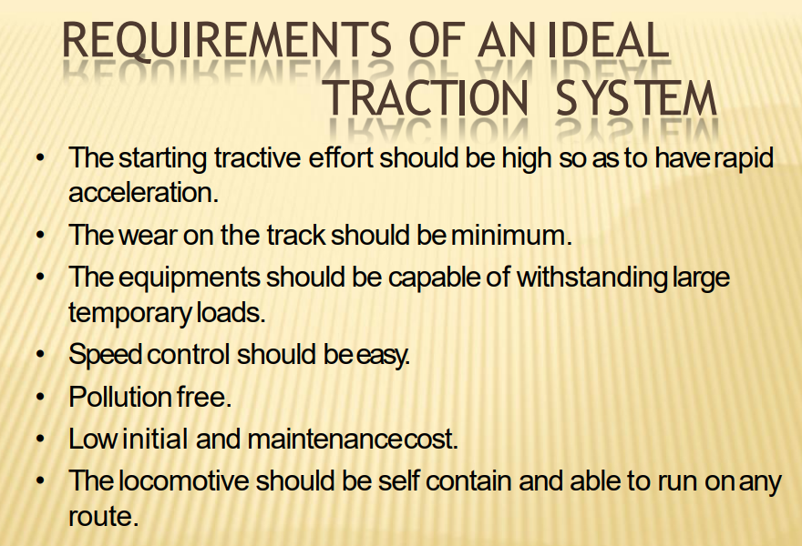

Slide 10
Advantages Of Electric Traction
Electric traction system is more clean and easy to handle.
No need of storage of coal and water that in turn reduces the maintenance cost as well as the saving of high-grade coal.
Electric energy drawn from the supply distribution system is sufficient to maintain the common necessities of locomotives such as fans and lights; therefore, there is no need of providing additional generators.
The maintenance and running costs are comparatively low.

Slide 11
The speed control of the electric motor is easy.
Regenerative braking is possible so that the energy can be fed back to the supply system during the braking period.
In electric traction system, in addition to the mechanical braking, electrical braking can also be used that reduces the wear on the brake shoes, wheels, etc.
Electrically operated vehicles can withstand for overloads, as the system is capable of drawing more energy from the system.

Slide 12
Disadvantages of Electric Traction
Electric traction system involves high erection cost of power system.
Interference causes to the communication lines due to the overhead distribution networks.
The failure of power supply brings whole traction system to stand still.
In an electric traction system, the electrically operated vehicles have to move only on the electrified routes.
Additional equipment should be needed for the provision of regenerative braking, it will increase the overall cost of installation.

Slide 13
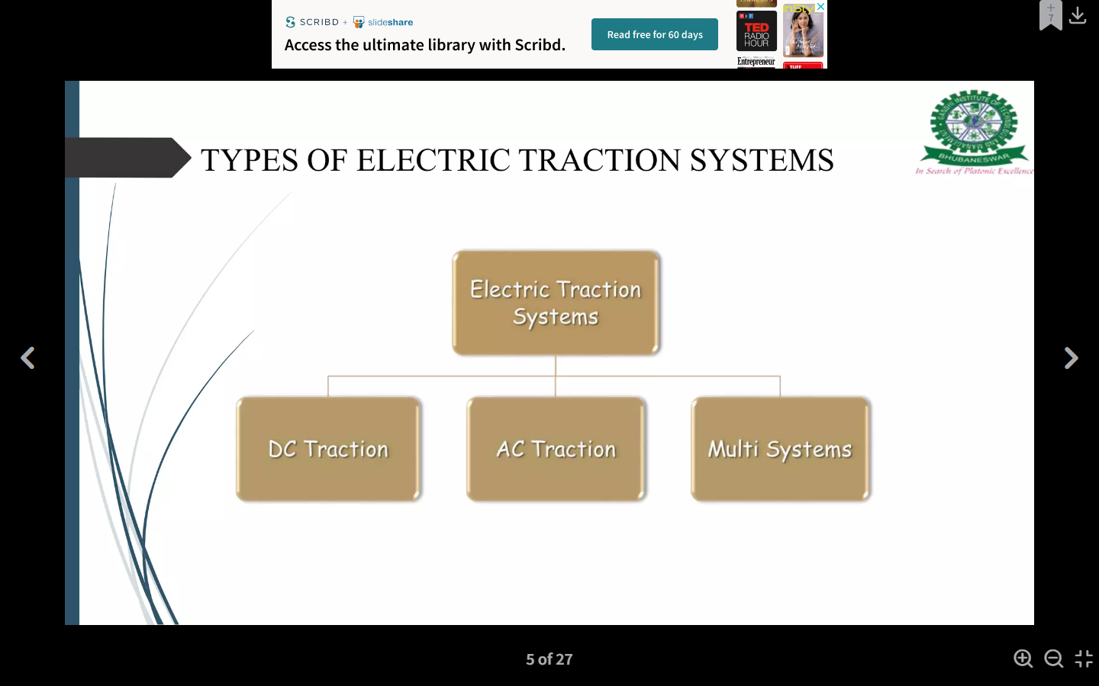

Slide 14
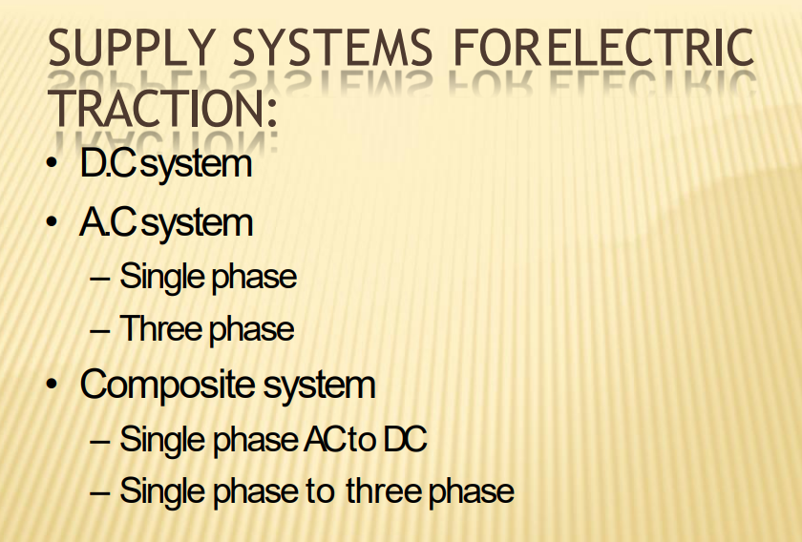

Slide 15
Supply Systems of Electric Traction
The way of giving the power supply to locomotive unit is generally referred as traction electrification system.
Presently, there are four types of track electrification systems are available based on the availability of supply. These are
DC traction system
Single phase AC traction system
Three phase AC traction system
Composite traction system

Slide 16
  Systems of track electrification
  DC System
  Single Phase AC System
  Three Phase AC System
  Composite System
  Single Phase - Three Phase System or Kando System
  Single Phase - DC System
  DC system
    In this system, D.C. series motors used for getting the necessary motive power, D.C. compound motors are also used for tramways and trolley buses where regenerative braking can be utilized.
    The operating voltage is from 600 V to 750 V for tramway and suburban railways and from 1500 V to 3000 V for mainline service.

Slide 17
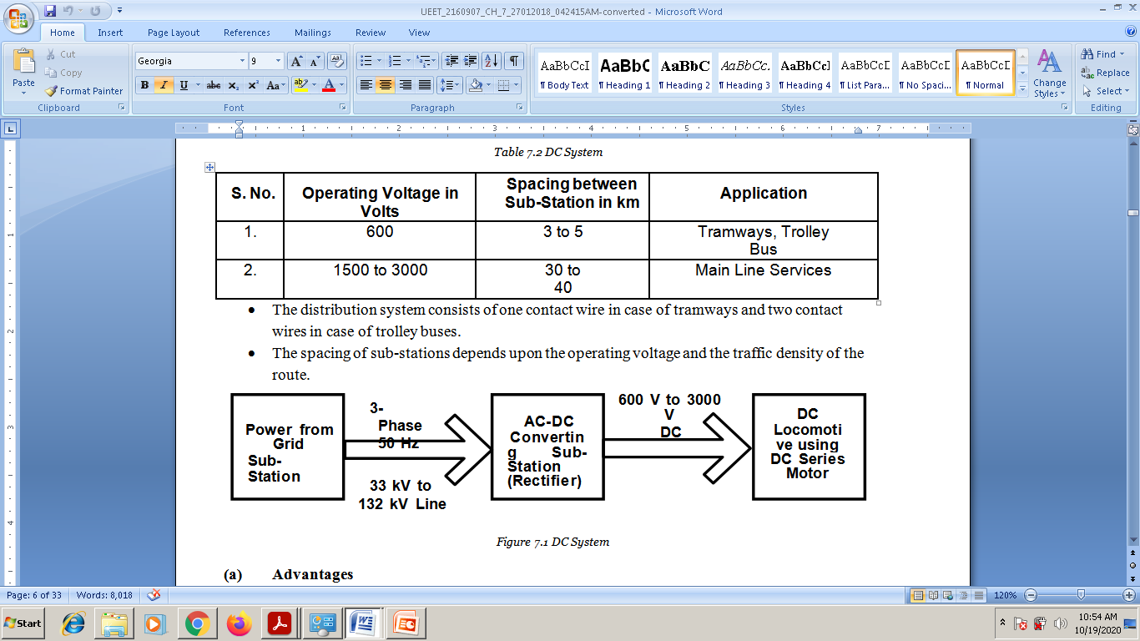

Slide 18
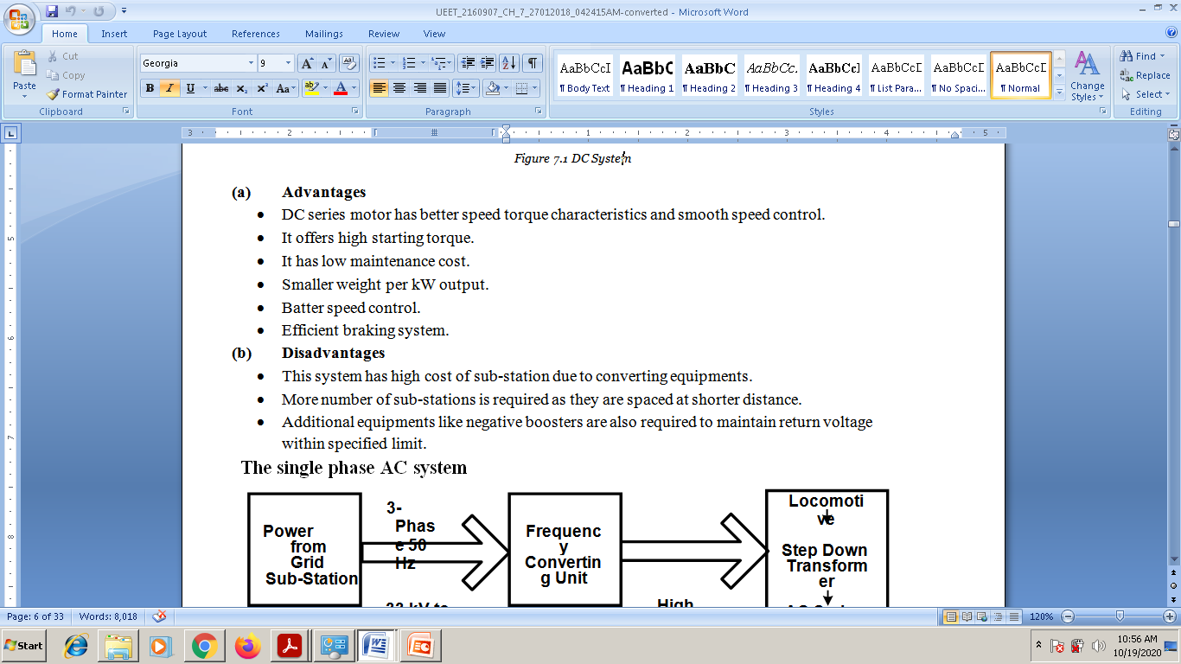

Slide 19
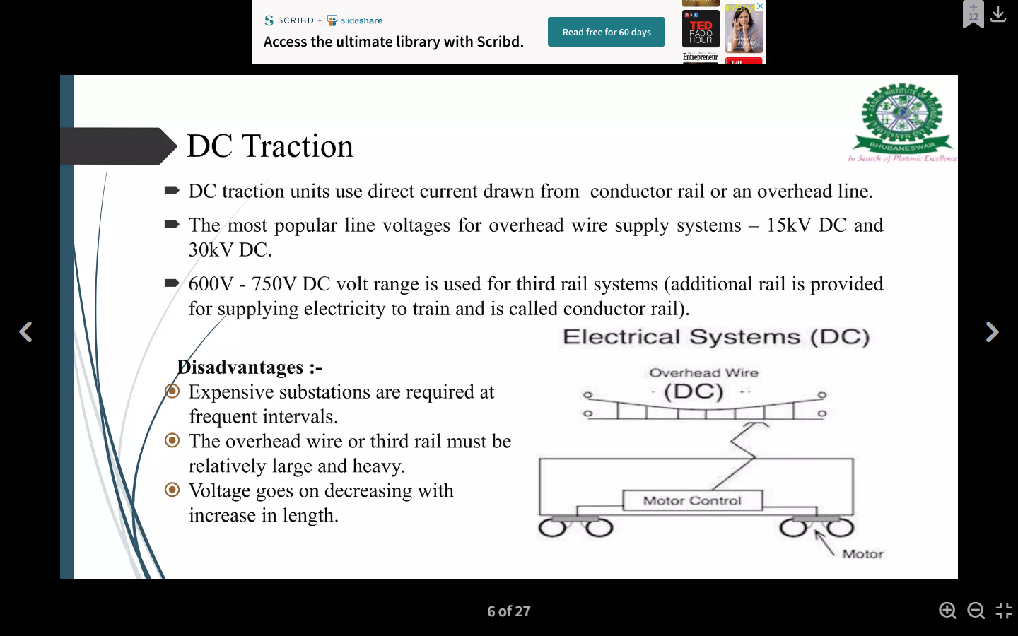
DC Traction

Slide 20
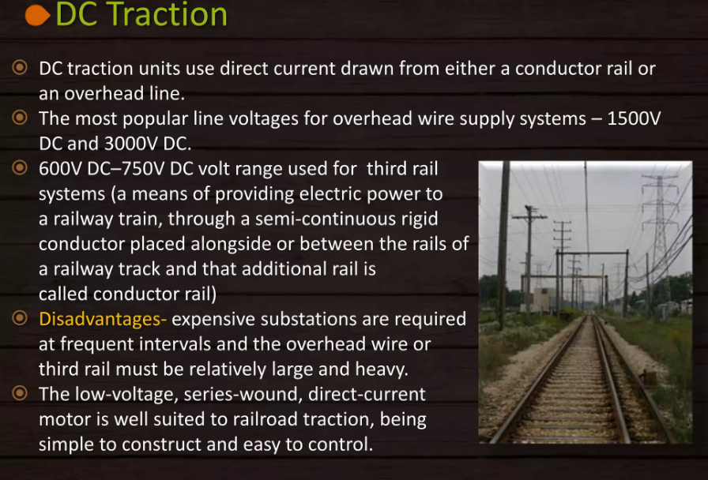

Slide 21
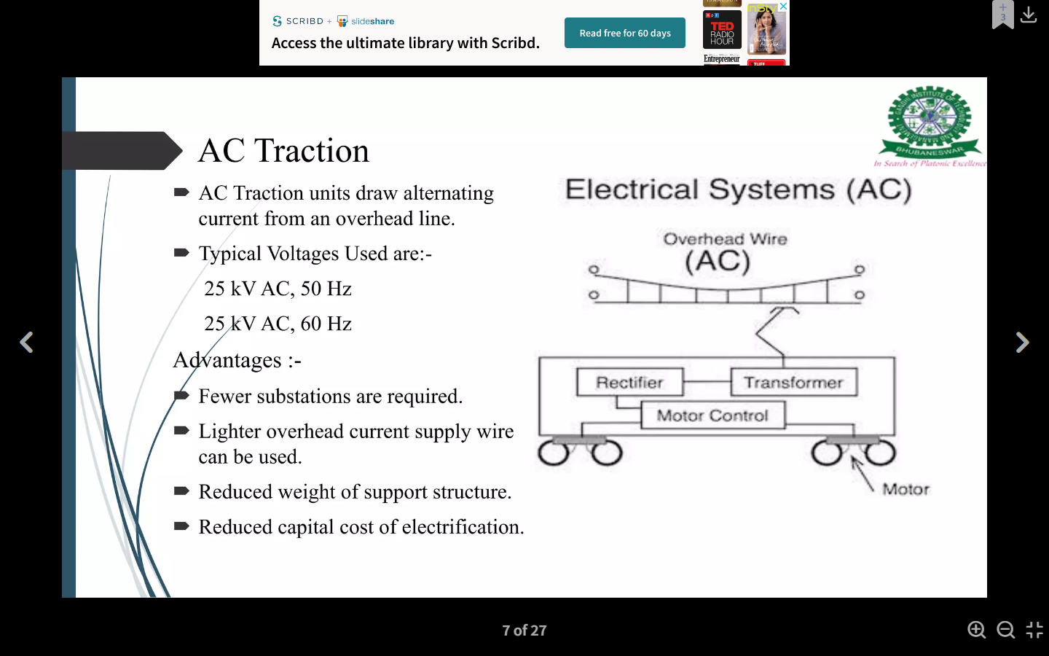
AC Traction

Slide 22
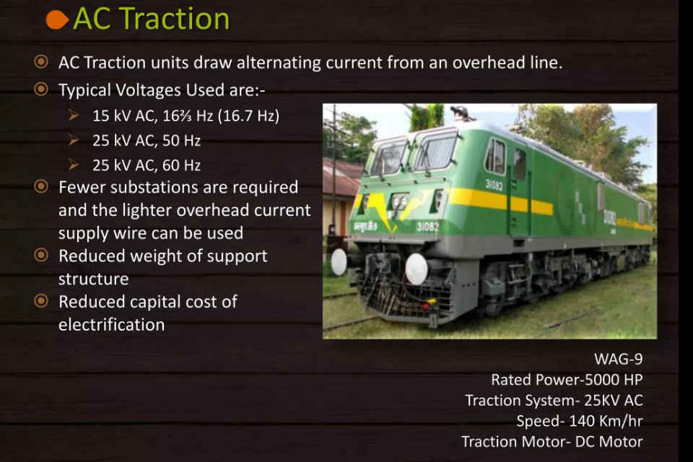

Slide 23
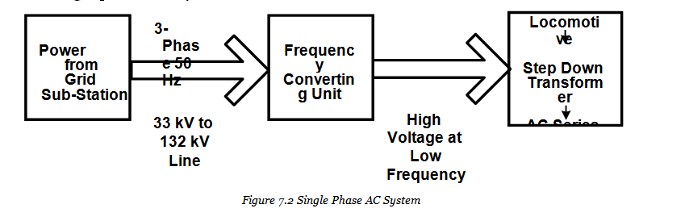
Single phase AC System
  In single phase AC system ac series motors are used for getting necessary motive power
  .The voltage employed for distribution network is 15 to 25 kV at 25 Hz, which is stepped down on locomotive to a low voltage suitable for supplying to single ac series motor.

Slide 24
    The spacing of substation is 50 to 80 km.
    The change of supply frequency become necessary because of
      Batter performance.
      Improves its commutation properties, power factor and efficiency.
      Reduces the line reactance and hence the voltage drop.
    AC single phase system is invariably adopted for main line service.

Slide 25
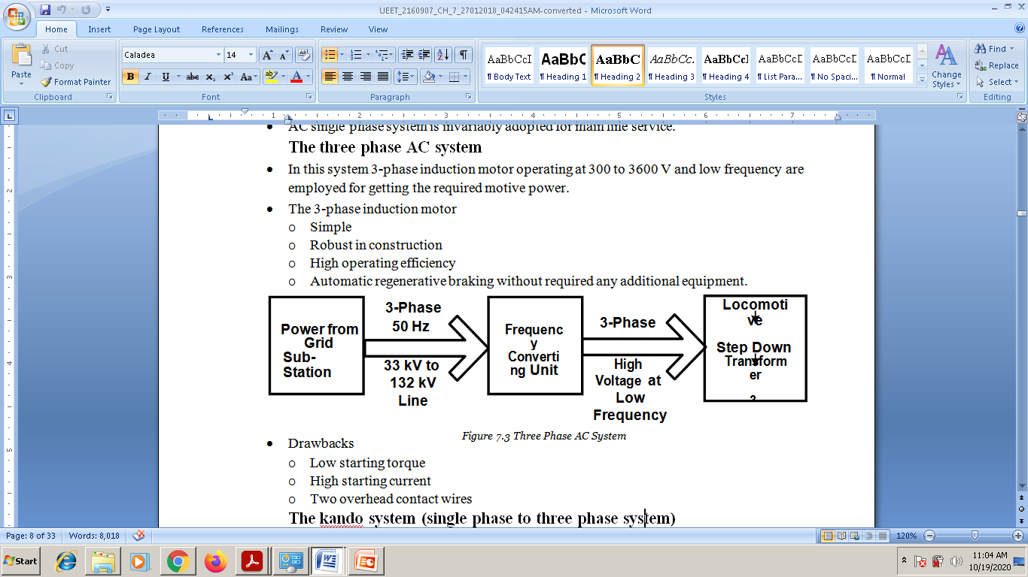

Slide 26
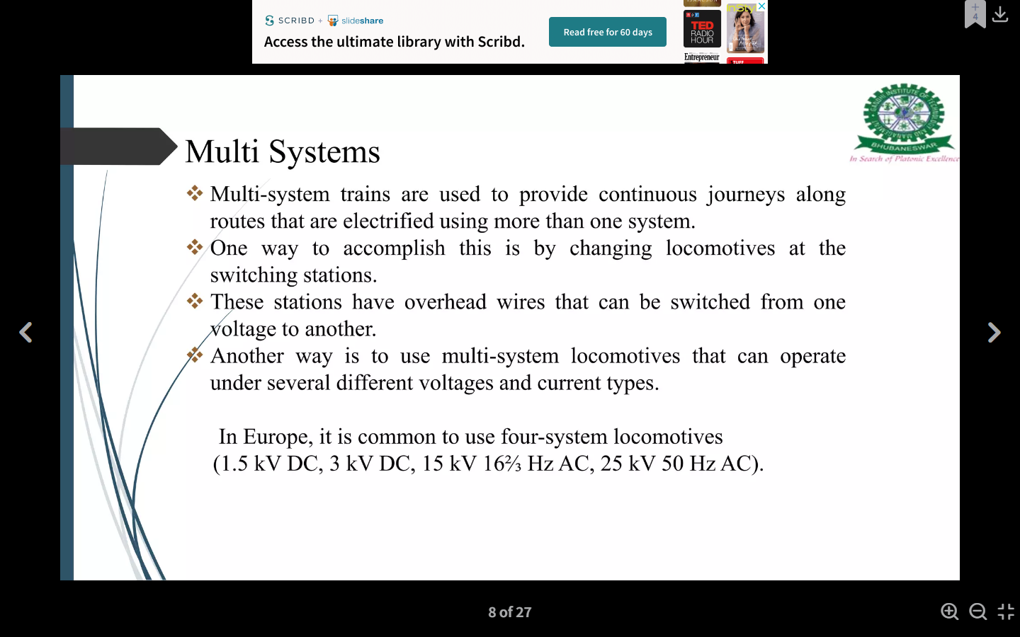

Slide 27
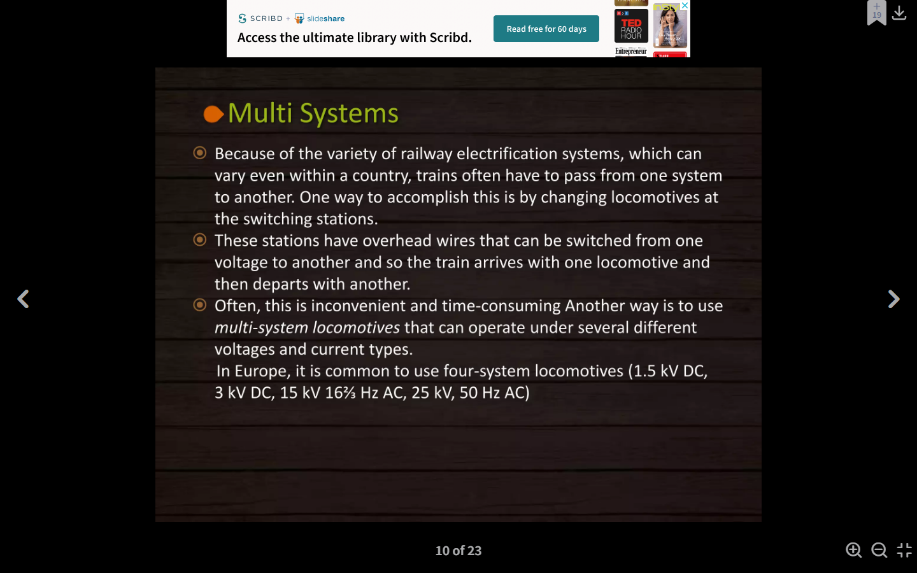

Slide 28
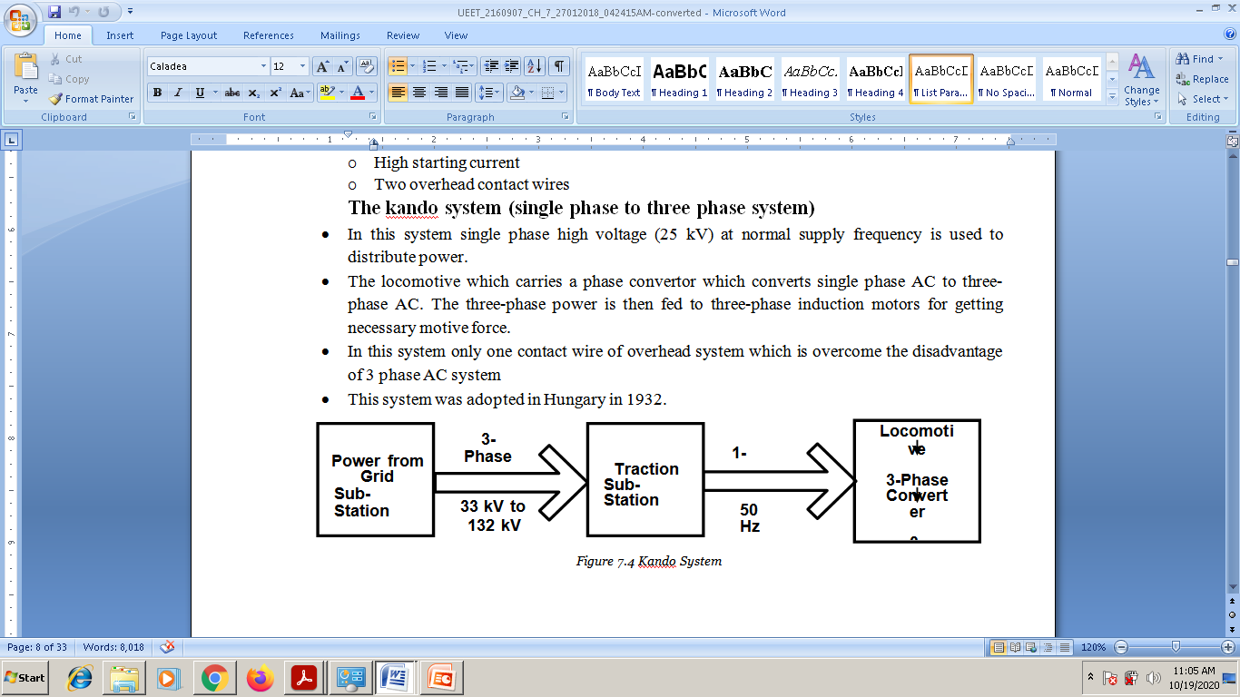

Slide 29
Single phase to DC system
This traction system is most popular and widely used system everywhere. It combines the single phase high voltage AC distribution at industrial frequency with DC series motor traction.
In this, the overhead line carries single phase, 25KV, 50 Hz supply which is then stepped down to a desired range using step-down transformer located in the locomotive unit itself.

Slide 30
This single phase supply is then converted into DC using rectifier (in the locomotive) and then applied to DC series motor.
The advantages of this system include higher starting efficiency, less number of substations, simple substation design and lower cost of fixed installations.

Slide 31
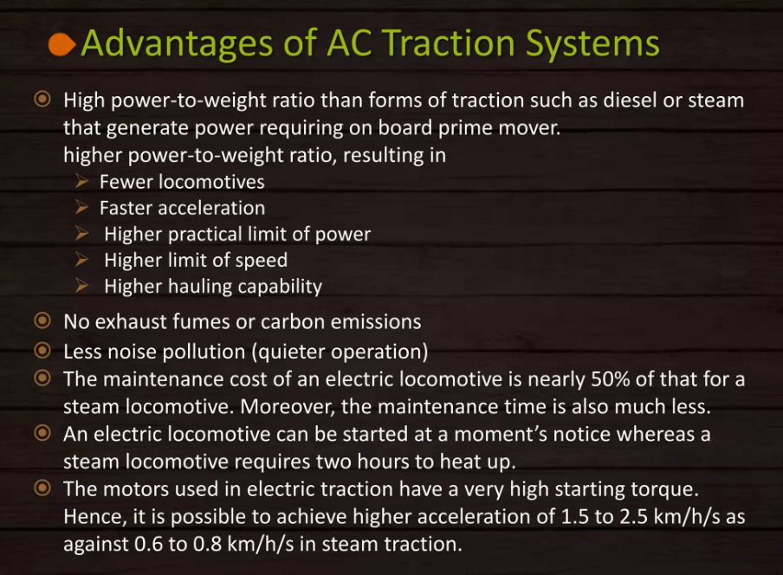

Slide 32
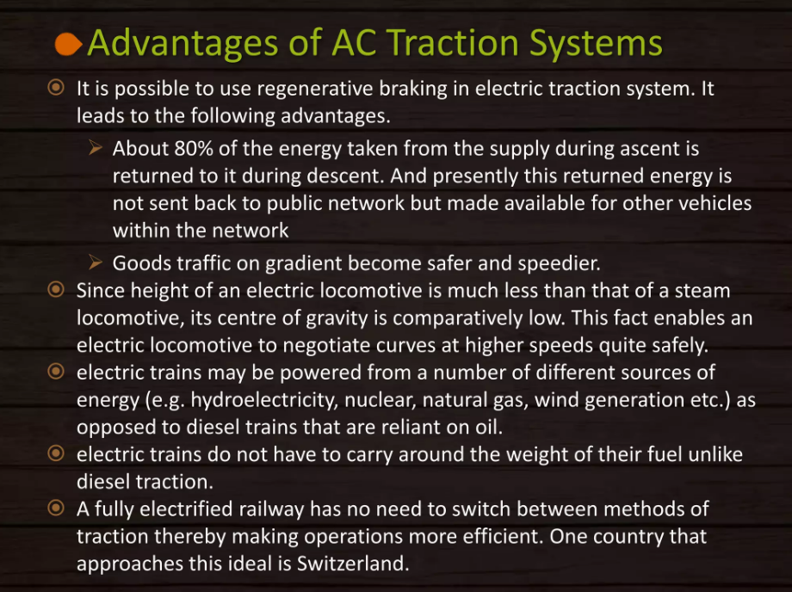

Slide 33
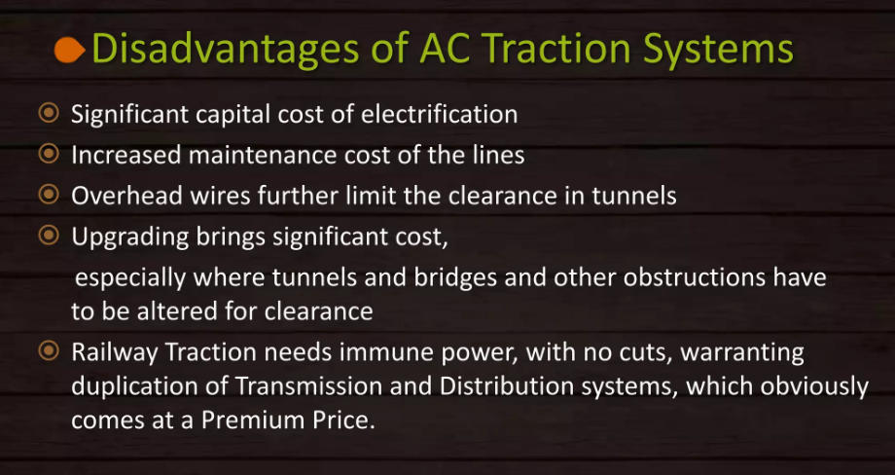

Slide 34
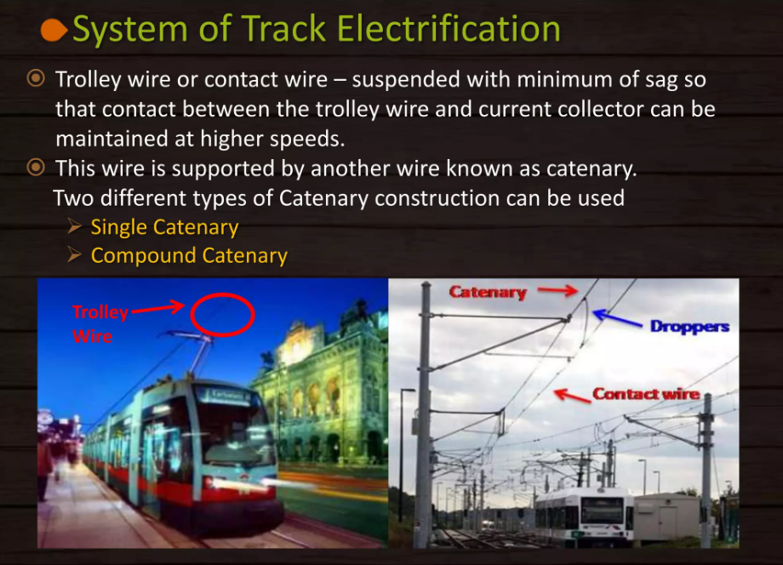

Slide 35
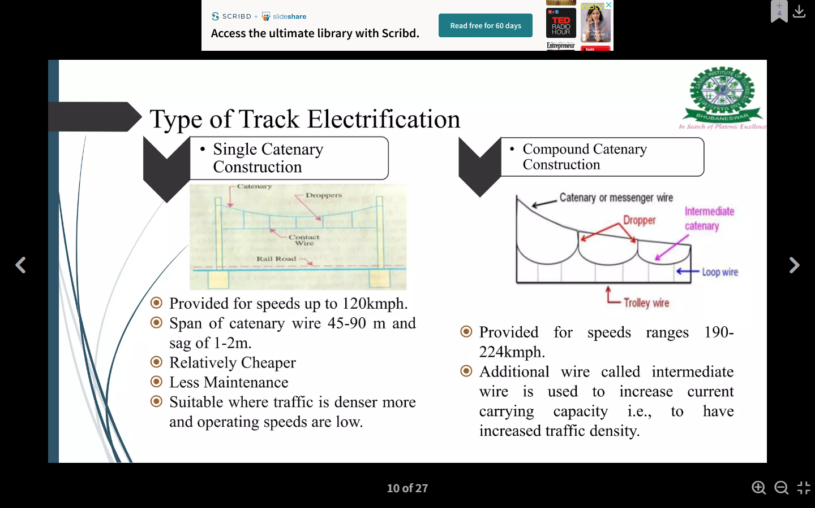
Type of Track Electrification

Slide 36
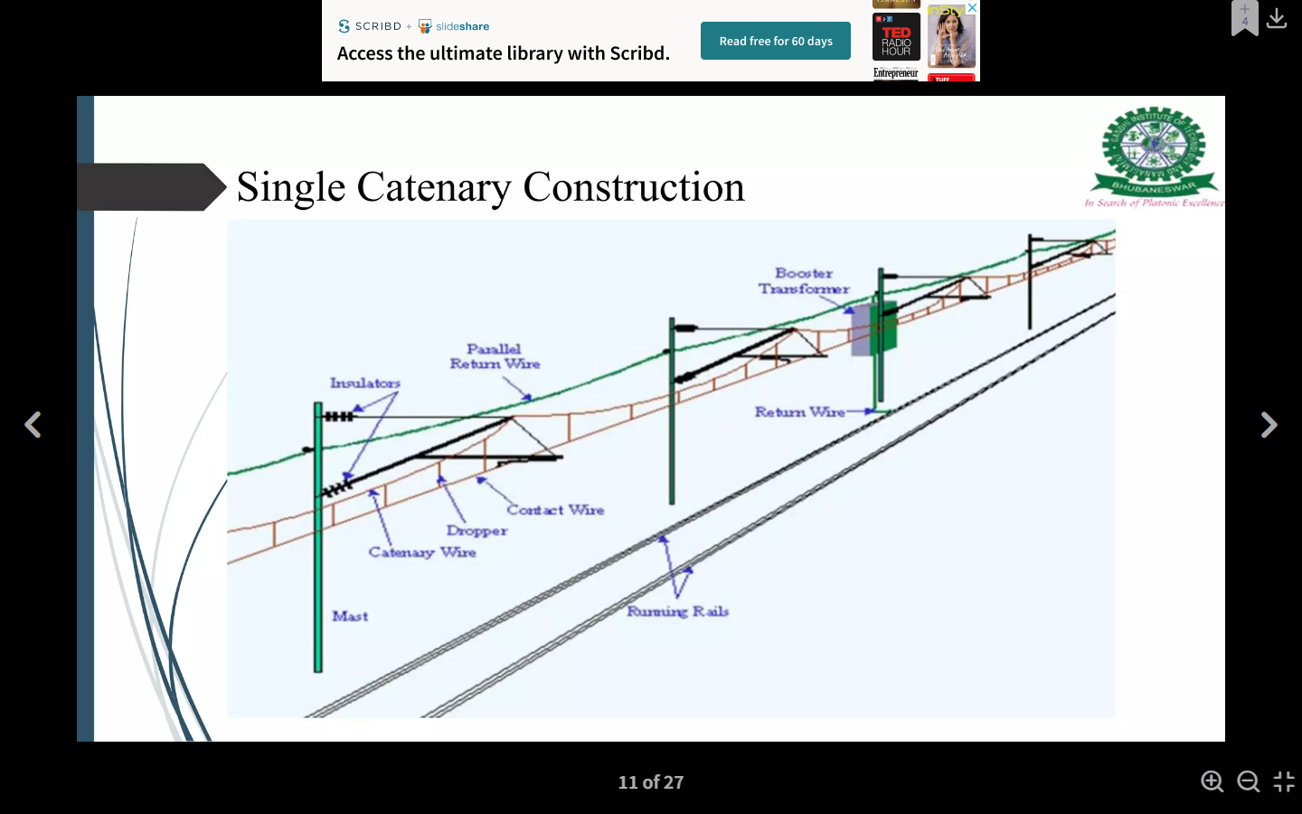

Slide 37
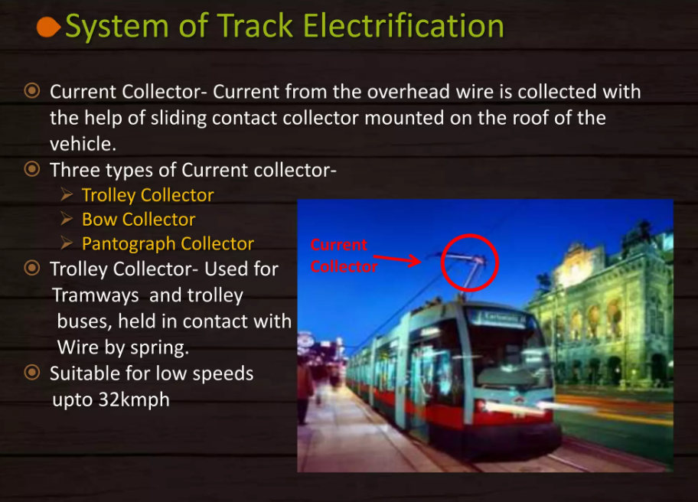

Slide 38
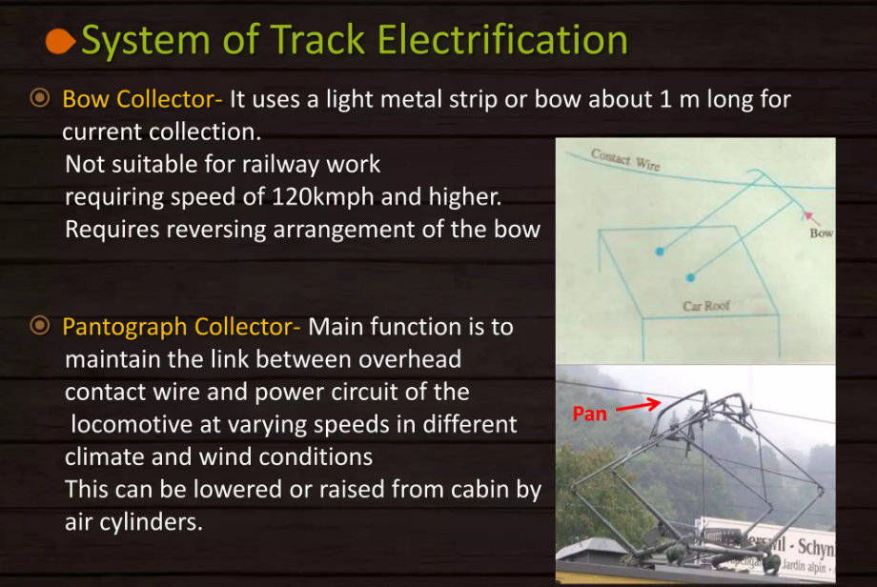

Slide 39
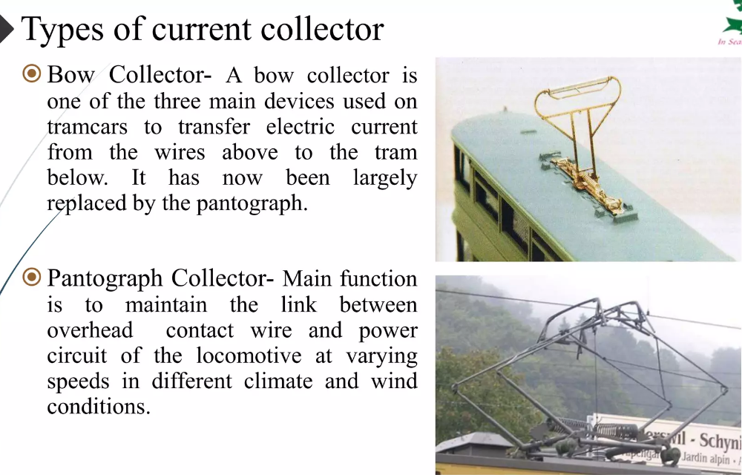

Slide 40
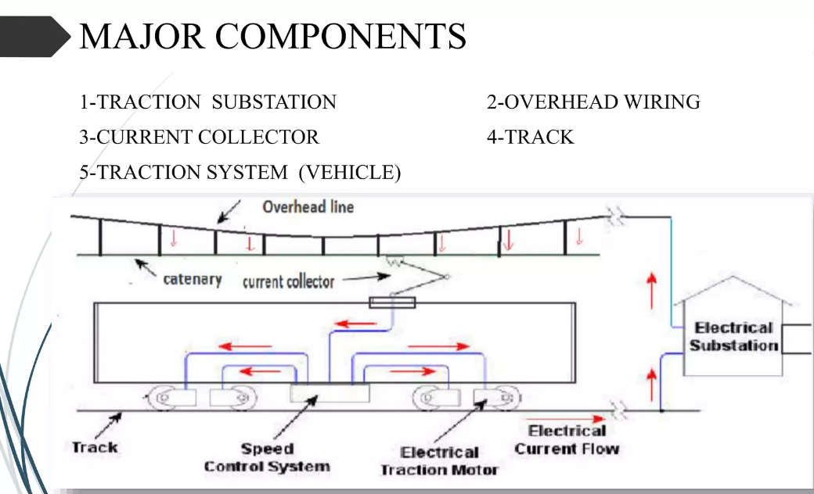

Slide 41
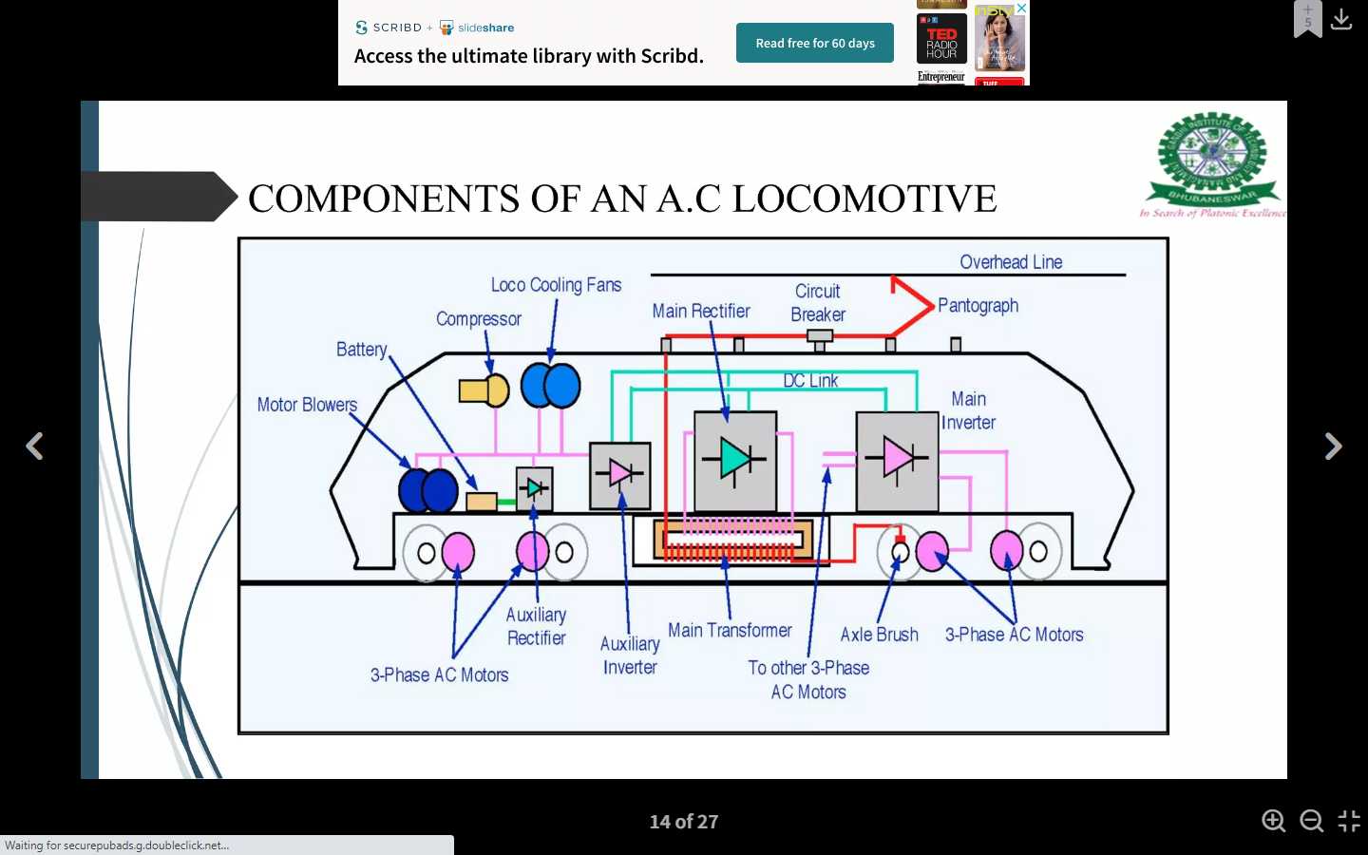

Slide 42
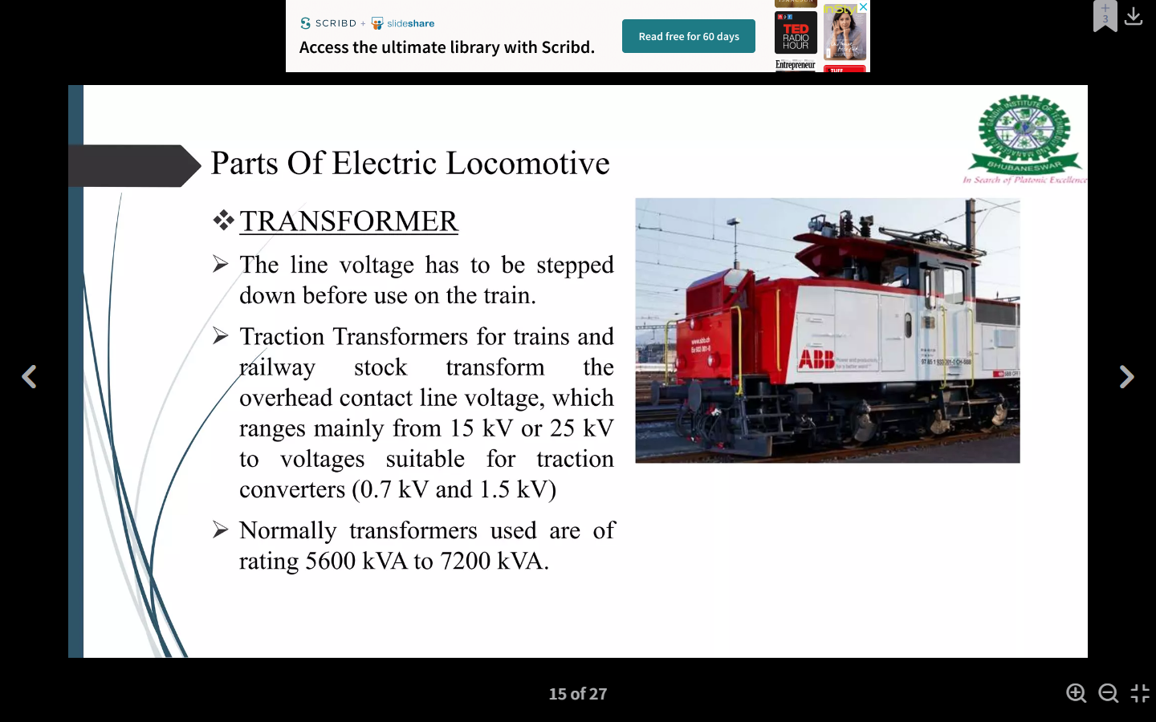
Parts of Electric Locomotive:

Slide 43
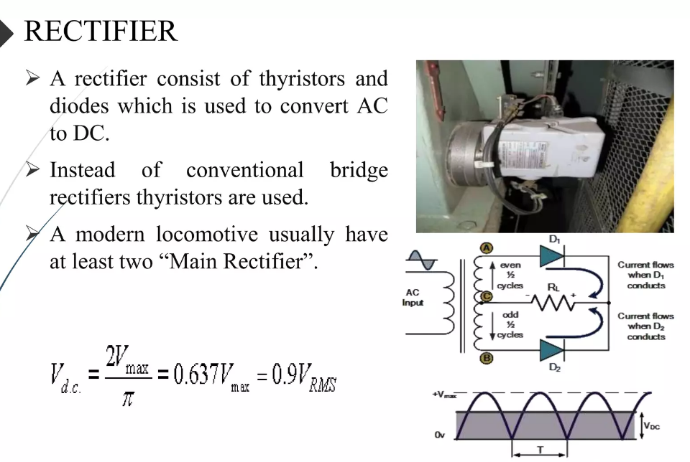
Output waveform

Slide 44
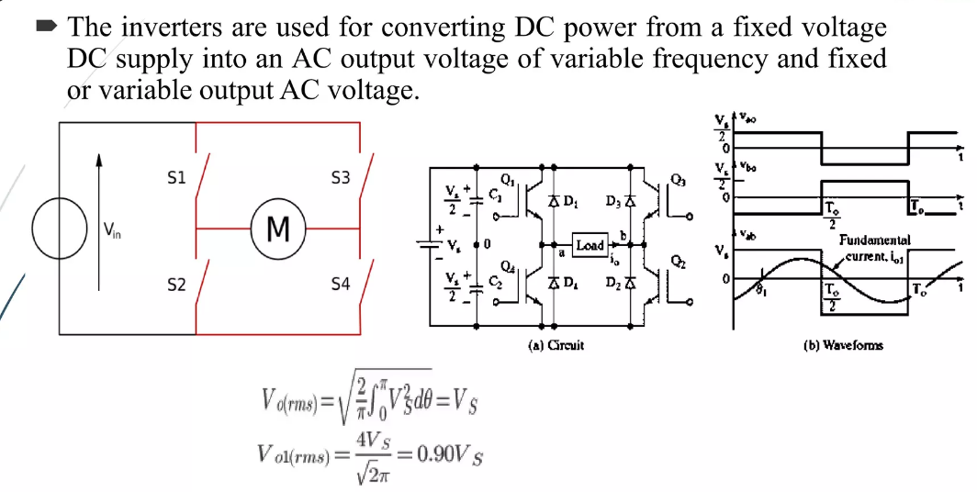
Inverter

Slide 45
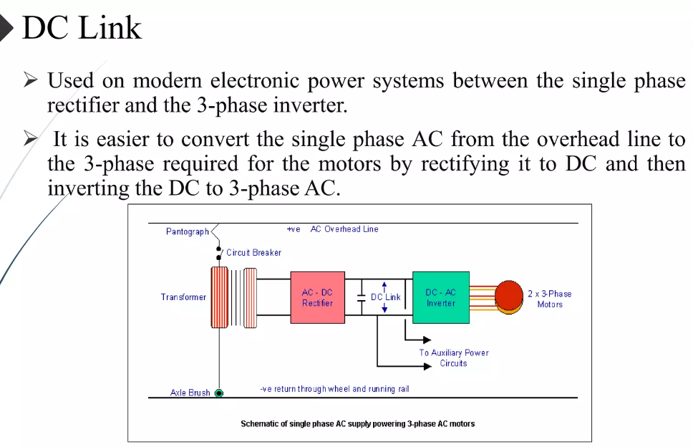

Slide 46
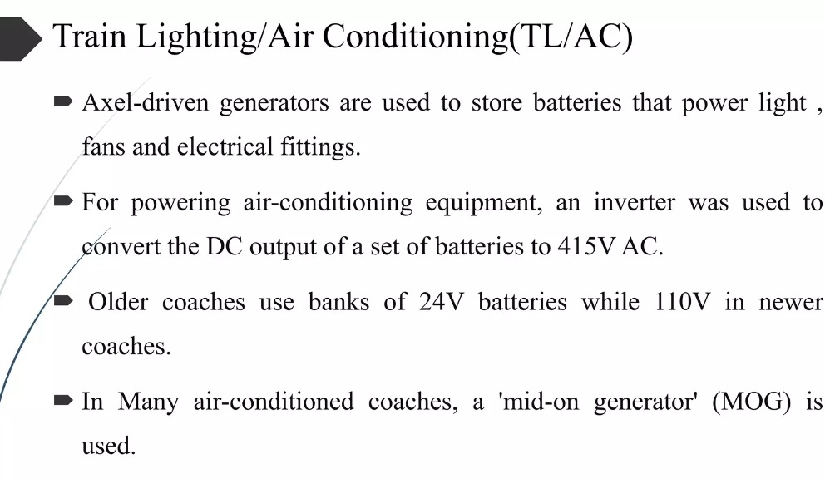

Slide 47
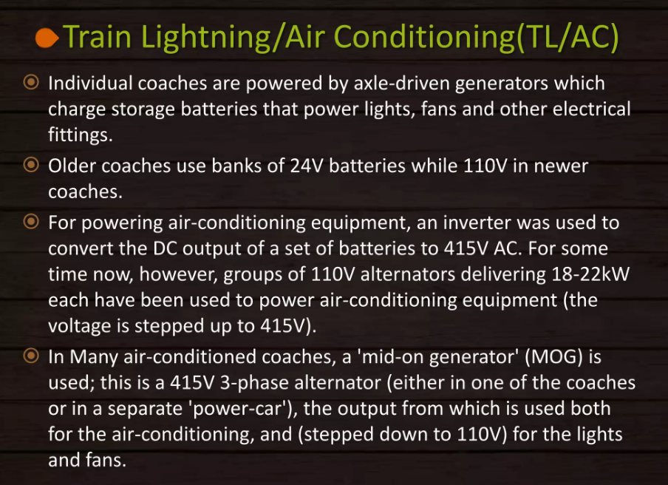

Slide 48
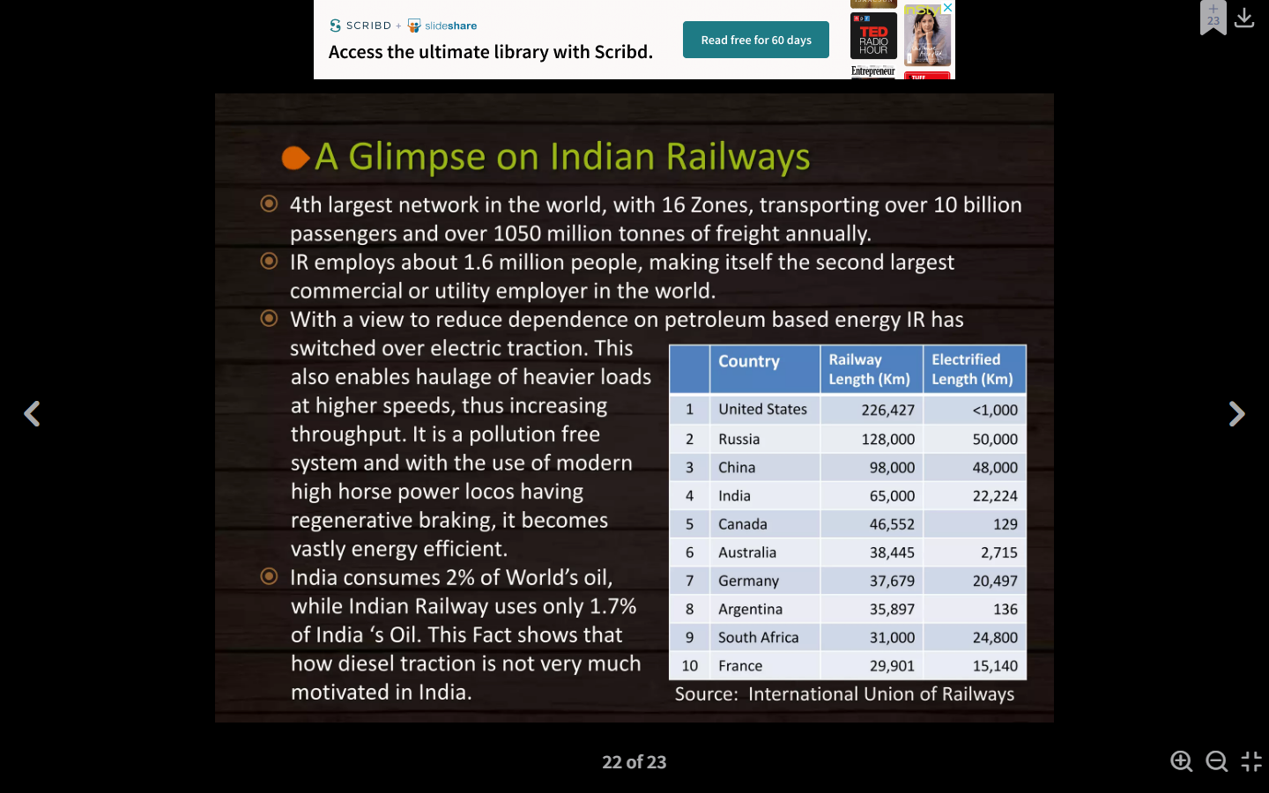

Slide 49
Special features of TRACTION MOTORS
Mechanical Features:
1. A traction motor must be mechanically strong and robust and it should be capable of
withstanding severe mechanical vibrations.
2. The traction motor should be completely enclosed type when placed beneath the locomotive
to protect against dirt, dust, mud, etc.
3. In overall dimensions, the traction motor must have small diameter, to arrange easily beneath
the motor coach.
4. A traction motor must have minimum weight so the weight of locomotive will decrease.
Hence, the load carrying capability of the motor will increase.

Slide 50
Electrical features
High-starting torque
Speed control
Dynamic and regenerative braking
Temperature
Overload capacity
Parallel running
Commutation

Slide 51
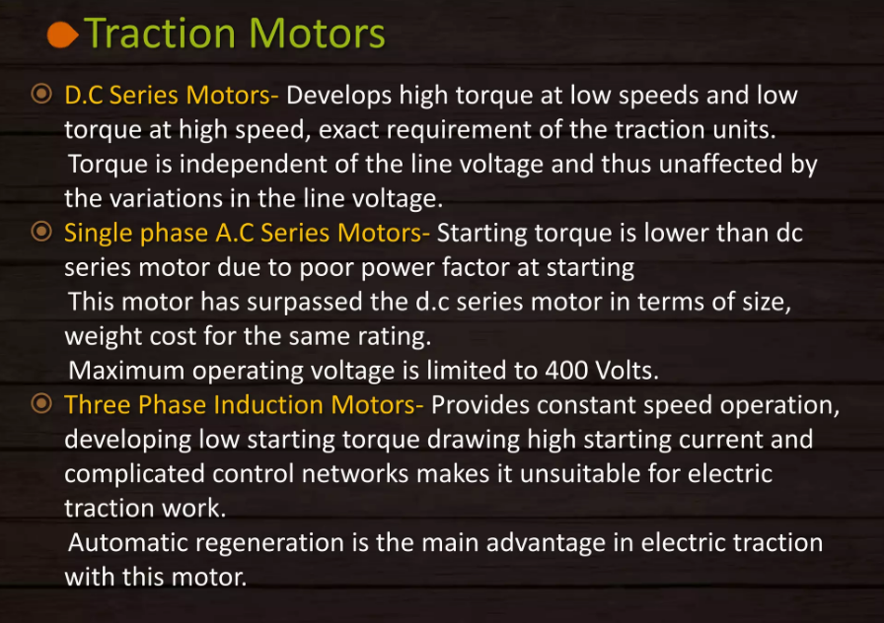

Slide 52
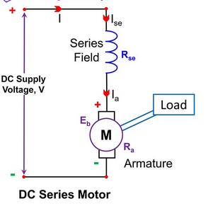
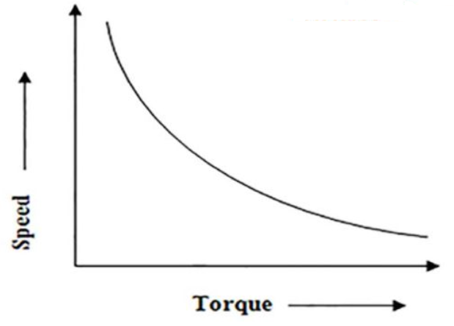
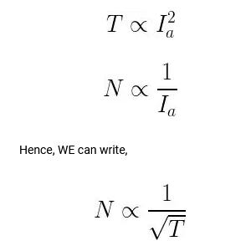
D.C. Series Motor

Slide 53
D.C. Series Motor
The aspects pertaining to the suitability of a dc series motor for traction duty are given below:
It generates high torque at low speeds and low torque at high speeds which is required to accelerate the vehicle.
Speed-torque and speed-current characteristics of a dc series motor are steep. So, the difference in speed of motors due to different wear of driving wheels is less.
As field flux is directly proportional to armature current, torque for a given current will not be affected by voltage fluctuations.
Series speed torque curve gives stable operation because as the speed increases, torque decreases.
If armature current increases (due to heavy load torque), then speed decreases. Therefore, the emf induced decreases and spark-less commutation can be obtained.
Since torque is proportional to the square of armature current, less current is needed to increase the torque. Therefore, the series motor can withstand heavy load torque.

Slide 54
D.C. Series Motor
For a given increase in torque, the horsepower (power = torque x speed, as torque increases, speed decreases) remains almost constant. This indicates the self-relieving property of the series motor.
Series motor is amenable to various speed control methods.
Without special arrangements, a series motor cannot be used for regenerative braking.
Since the series field time constant is low, the back emf becomes zero in case of power failure. So, the initial rush of current on temporary interruption of supply is more in the series motor.
Applications of Series Motor :
Due to low weight and high starting torque, series motors can develop high starting torque. Therefore, they are suitable for urban and suburban services where a high rate of acceleration is required which can be met by a series motor. In a 1500V dc system, the dc series motor may be operated either at 1500V or 750V by connecting them in series permanently.

Slide 55
Single Phase A.C. Series Motor
If an ordinary dc series motor is fed from an ac supply, it would operate as ac series motor but not very satisfactorily owing to the following reasons:
Since the field and armature currents both reverse every half cycle, the torque would be exerted at a double frequency in one direction.
The alternating flux set up by the field winding due to alternating current causes excessive eddy current losses in fixed core and yokes, thereby increasing the motor temperature and decreasing the operating efficiency.
The inductance of field and armature winding decreases the power factor and causes some abnormal voltage drops which in turn affects the performance of the motor.
There will be heavy sparking at the brushes undergoing commutation.
In order to reduce the reactance of the series field, ac series motors are built with as few turns as possible.

Slide 56
Single Phase A.C. Series Motor
Reduction in the number of turns on the field winding results in the reduction of flux per pole leading to an increase in the speed for a given current and therefore there would be a reduction in the load torque available for a given current. Hence to develop the required load torque, the number of armature conductor have to be increased proportionately.
The increase in armature conductors would increase inductive reactance of the armature which can be neutralized by providing the compensating winding (compensating winding neutralizes completely the armature MMF).
The air gap is made very small because of a very weak field which is necessary to obtain a high power factor.
The yoke and field of the motor are laminated in order to reduce eddy current losses.
To reduce sparking, brush width is decreased.
Series inductive reactance is directly proportional to the frequency, so ac series motor characteristics are better at low frequencies.

Slide 57
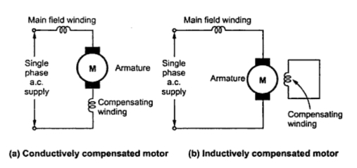
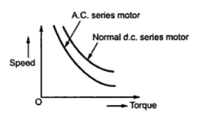
Single Phase A.C. Series Motor

Slide 58
Single Phase A.C. Series Motor
Applications of Single Phase AC Series Motor :
The operating characteristics of an ac series motor are similar to a series motor. In which speed is inversely proportional to the armature current and the torque produced will be equal to the square of the armature current.
In a traction system, an AC series motor of several hundred KW is usually employed.
Due to poor power factor at starting, AC series motor has low starting torque compared to DC motor.
So, they are not suitable for urban and suburban services where high starting torque is needed. So they can be employed for mainline traction service.

Slide 59
Three Phase A.C. Induction Motor
Earlier three-phase induction motor was considered a constant speed machine. But with the advent of power electronics, many characteristics of a three-phase induction motor can be modified to suit the requirements of traction.
The factors governing the suitability of a three-phase induction motor for traction applications are given below.
It has many advantages as simple, robust construction, trouble-free operation, less maintenance, and high voltage operation requiring reduced current and easy braking.
With the development of power electronic inverter circuits, the variable output frequency can be obtained. This can be used to control the speed of a three-phase induction motor.
With variable-frequency input to the induction motor, good efficiency and power factor can also be obtained by lowering the synchronous speed of the motor.
Starting current of the motor can be decreased by starting the motor at a low frequency using semiconductor converters.

Slide 60
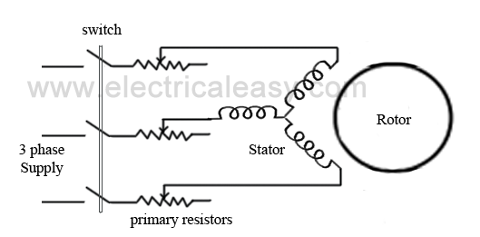
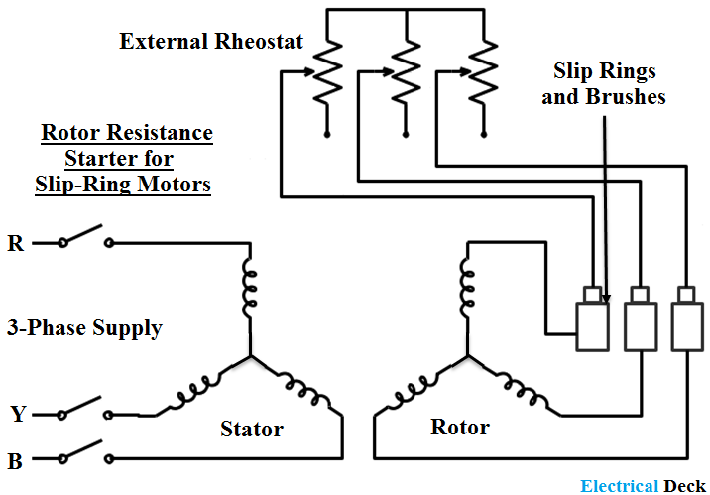
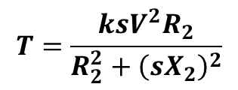
Squirrel Cage Induction Motor
Slip Ring Induction Motor
$$T=\frac{ksV^{2}R_{2}}{R_{2}^{2}+{\left(sX_{2}\right)}^{2}}$$

Slide 61
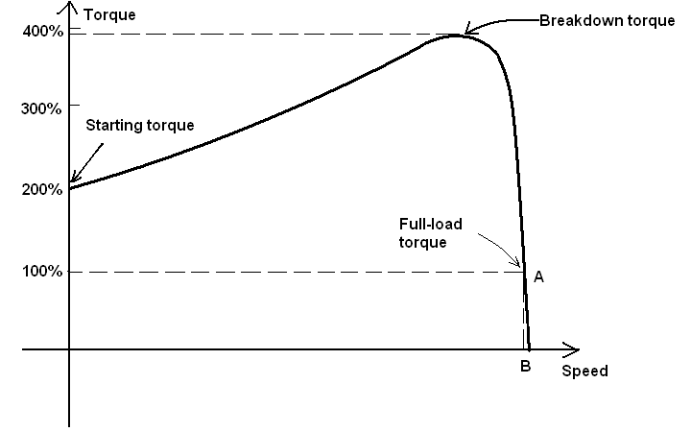
Torque-Speed Characteristics of Three Phase Induction Motor

Slide 62
Three Phase A.C. Induction Motor
Applications of Three-Phase Induction Motor :
The traction systems employing three-phase induction motors consist of two overhead conductors for two phases and a track rail for the third phase. This makes the overhead structure complicated and may also lead to electric shock if any person gets in contact with the third rail.
This can be overcome by using the Kando system. In this system, a single-phase high voltage supply is given by a single overhead conductor. The locomotive has phase converters that will convert the single-phase to three-phase at the desired frequency and feed it to the three-phase induction motor.

Slide 63
Comparison between DC traction and AC traction Motors
Factor | DC Traction | AC Traction
Motor | DC series motor. | AC series motor.
Performance | Good performance. | Not as good as that used for DC traction.
Starting torque | More. | Less.
Speed control | The speed control of DC series Motor is limited. | Wide range of speed control is Possible.
Interference | DC system causes less interference with Communication lines. | It will produce more interference with Communication lines.
Overhead distribution | Heavier and more costly Comparatively. | Lighter and less costly.
Substations | The number of substations required for a given track distance on DC traction is More. | The number of substations required in AC traction is less.
Weight of Copper | Weight of cu required per track km is more. | Weight of cu required per track km is less.
Application | Tramway, Trolley bus. | Main Line Service.

Slide 64
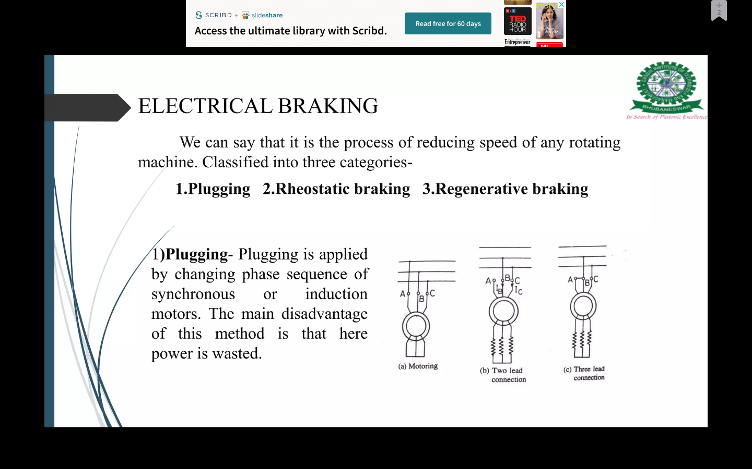

Slide 65
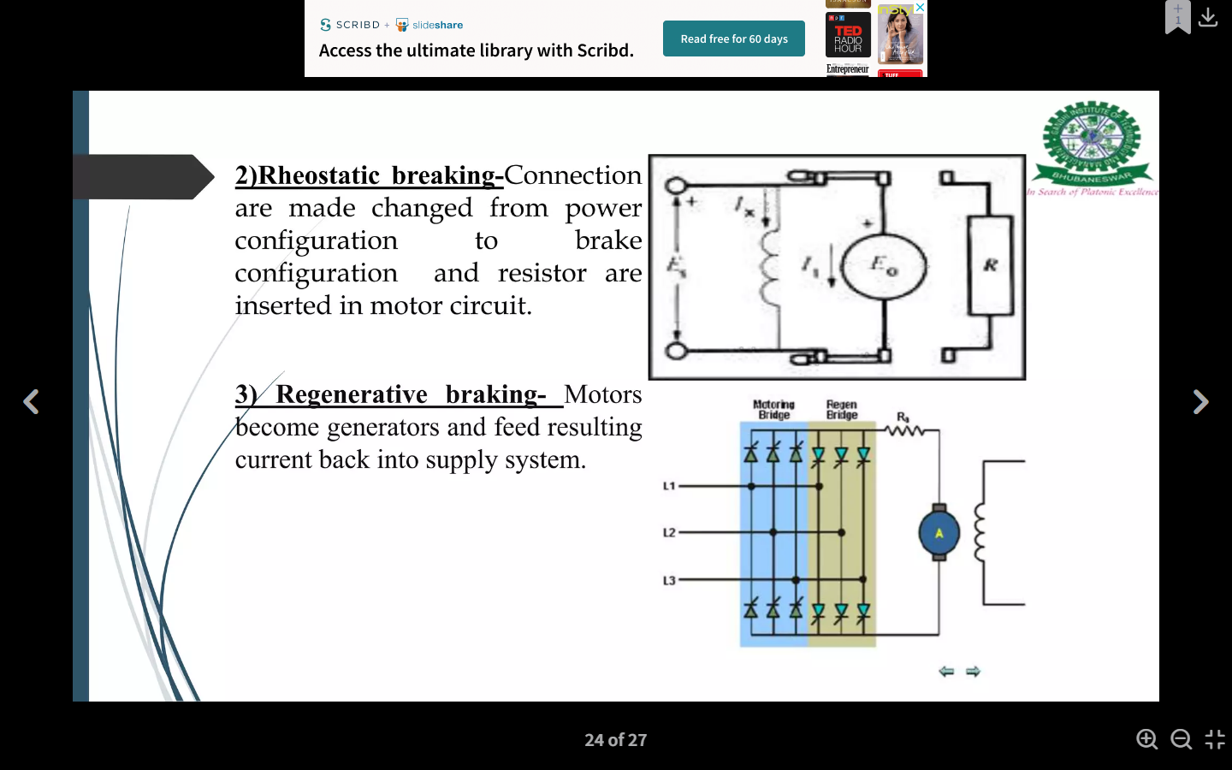

Slide 66
Mechanics of Train Movement
It is the effective force acting on the wheel of locomotive, necessary to propel the train is known as ‘tractive effort’. It is denoted with the symbol Ft.
The tractive effort is a vector quantity always acting tangential to the wheel of a locomotive. It is measured in newton.
The net effective force or the total tractive effort (Ft) on the wheel of a locomotive or a train to run on the track is equals to the sum of tractive effort:
1. Required for linear and angular acceleration (Fa).
2. To overcome the effect of gravity (Fg).
3. To overcome the frictional resistance to the motion of the train (Fr).
Mechanics of train movement
The electric locomotive consists of pinion and gear wheel meshed with the traction motor and the wheel of the locomotive.
Here, the gear wheel transfers the tractive effort at the edge of the pinion to the driving wheel.

Slide 67
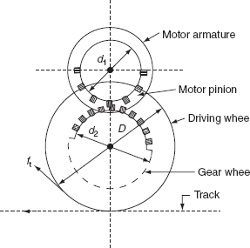
Mechanics of Train Movement

Slide 68

Mechanics of Train Movement

Slide 69

Mechanics of Train Movement
Here, the armature of the driving motor has a pinion of the diameter d₁ attached to it.
The tractive effort at the edge of the pinion is transferred to the driving wheel by means of a gearwheel.

Slide 70

Mechanics of Train Movement

Slide 71
Mechanics of Train Movement
The maximum frictional force between the driving wheel and the track is equal to μW.
Where, μ is the coefficient of adhesion between the driving wheel and the track and W is the weight of the train on the driving axles, known as adhesive weight.
The adhesive weight is defined as the total weight to be carried on the driving wheels. The slipping will not take place unless
F_{t} > μW
Therefore, for the motion of trains without slipping, the tractive effort should be less than or at the most equal to μW.
From the above discussion it is clear that the magnitude of the tractive effort that can be employed for propulsion of train depends upon the weight coming over the driving wheels and the coefficient of adhesion between the driving wheel and the track.

Slide 72
Coefficient of Adhesion
The coefficient of adhesion is defined as the ratio of the maximum tractive effort that can be applied without slipping of wheels to the adhesive weight, i.e.,
Also, the coefficient of adhesion decreases with the increase in speed. The normal value of the coefficient of adhesion with the clean and dry rails is 0.25 and with wet or greasy rails it is as low as 0.08.
Since the higher value of tractive effort can be used in electric traction so that the electric train can be made to accelerate at a faster rate. This results in saving of time, especially, when the distance between the stops is small.

Slide 73

Problem: An electric train has eight motors geared to driving wheels, each wheel is 80 cm in diameter. Determine the torque developed by each motor to accelerate the train. The tractive effort required for accelerating the train to a speed of 50 kmph in 30 seconds is of 117590 N, the gear ratio is 4 to 1 and the gearing efficiency is 85%.

Slide 74


Slide 75


Slide 76


Slide 77


